Slide 1
Make a power connection circuit
Make a Demo Design for 3d Box
Make an Arduino PerformAt Function
Make an Arduino Phone Call Function
Make an Arduino SMS Read Function
Integrate Rpi Cam V1.3 With Rpi4
Make a Script to take Photos and Videos
Make a search about Models For Face Detection
Design The database
Make a plan for server side
Make a plan for Video Streaming
Code Home Page
Code Live Stream Page
Next Tasks

Slide 2


Design of Autonomous Vehicle Driving , Tracking and Monitoring
Ministry of Higher Education
Pyramids High Institute (PHI) for Engineering and Technology
Electronics and Communication Engineering Department
Under Supervision
Dr. Gamal Elshiekh
Dr. Esraa Elrefaey
Team Members
Abdelrahman Shrief
Asmaa Mohamed
Sondos Reda
Mohammed Hossam
Mohammed Alaa
Mohammed Nageh
Mahmoud Gaballah
Moamen Mourad

Slide 3
Outlines
Introduction about project idea
Applying GPS theory on the project
Connecting the project with users via GSM Solutions
Making a video streaming in a web application
Applying face detection and recognition for drivers
Make a connection between users and the device via Web App
Implement a backup plan for network connection failing
Testing the project idea on a self-driving car
Apply the project idea and test it for real vehicles
Conclusion & future work

Slide 4
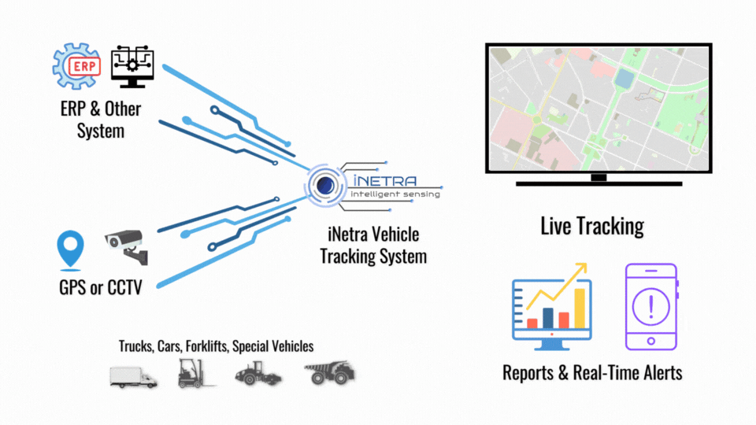
Project Layout
Rpi 4 Model B
Main MCU
GPS Technology
GSM
Connectivity
Web Application
Security Schema
Testing with
Self-Driving Car
Testing with
Real Vehicles
SIM808
SIM808
Driver Face
HTML
PHP
Rpi cam V1.3
Css

Slide 5
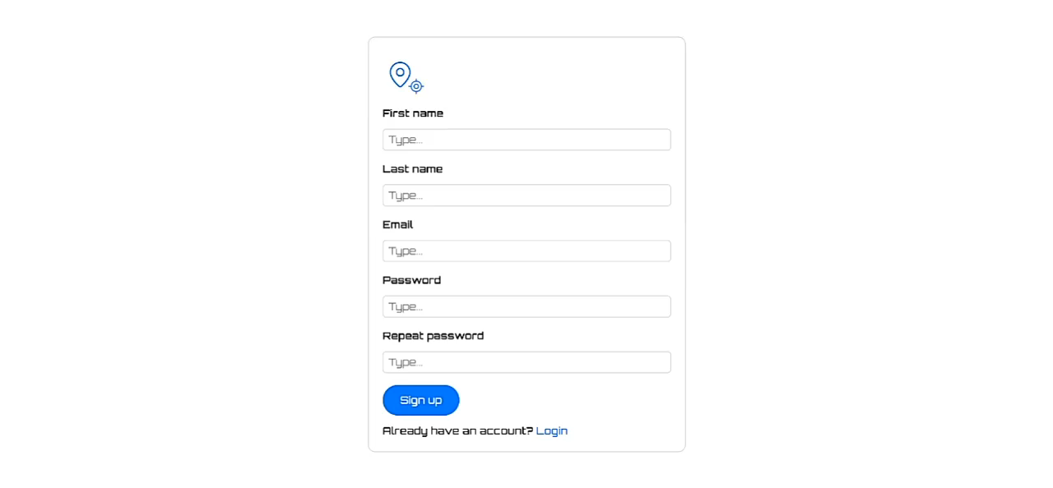
Web Application Design

Slide 6
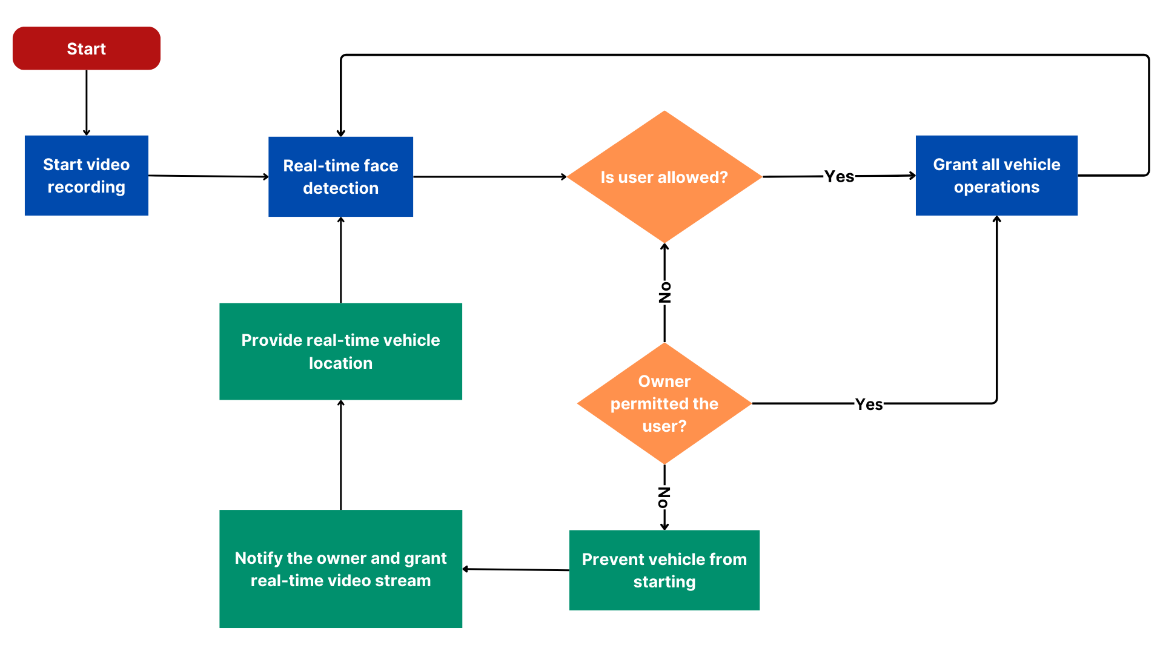
Project Security Schema

Slide 7
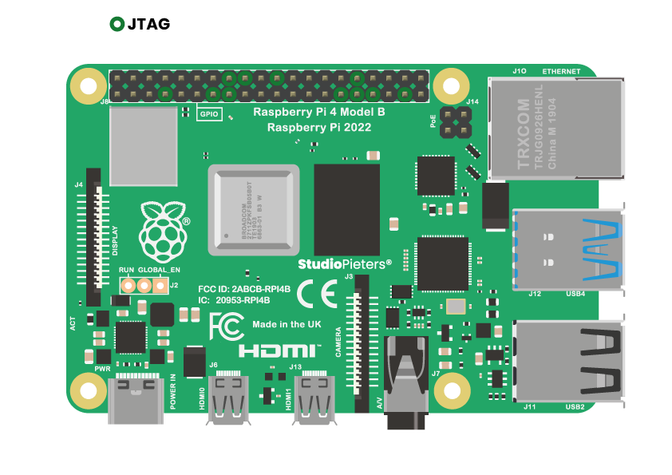

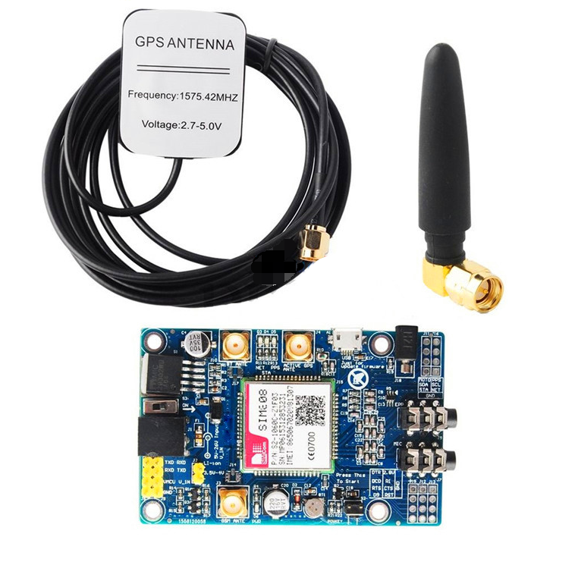
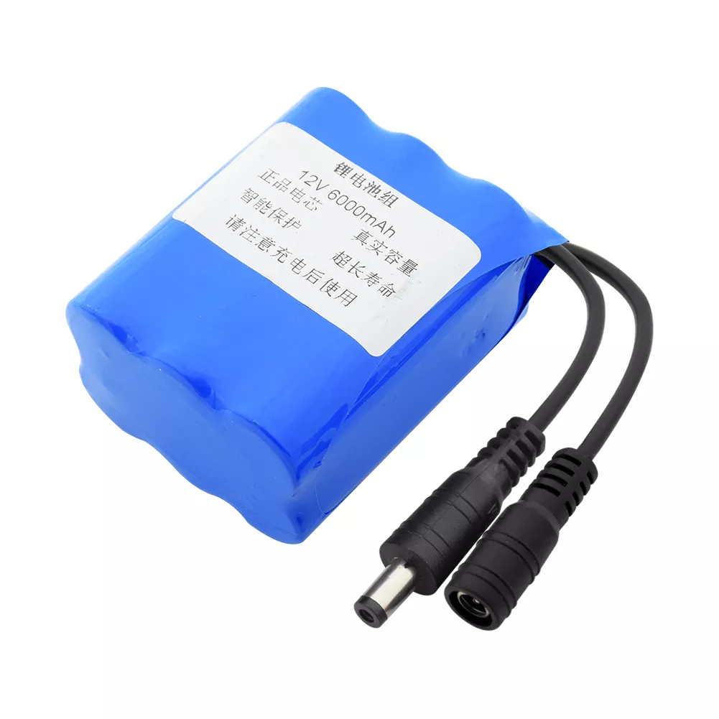
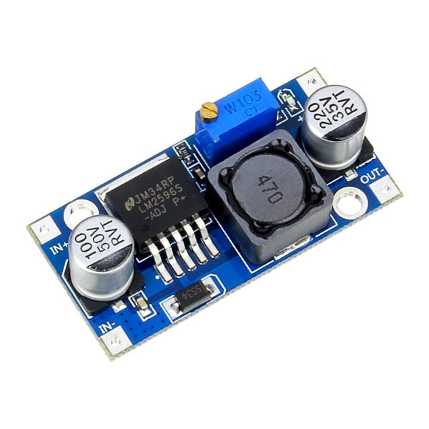
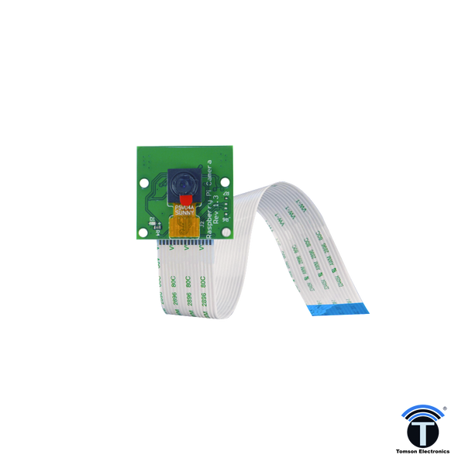
Hardware Block Digram
GSM + GPS Module
Main Controller
Server
DC-DC Converter
Battery
Camera
Conclusion

Slide 8
Raspberry pi 4 model B
Specifications
Broadcom BCM2711, Quad core Cortex-A72 (ARM v8) 64-bit SoC @ 1.8GHz
2.4 GHz and 5.0 GHz IEEE 802.11ac wireless, Bluetooth 5.0, BLE
2 USB 3.0 ports; 2 USB 2.0 ports.
Raspberry Pi standard 40 pin GPIO header
2 × micro-HDMI® ports (up to 4kp60 supported)
2-lane MIPI CSI camera port
Micro-SD card slot for loading O.S and data storage
5V DC via USB-C connector (minimum 3A*)
Usage and main functions
Manage H.W Components
Works As Local Server
Resbonsable for Face Recognition
Back

Slide 9
GSM + GPS Module
Specifications
Controlled by AT Command
Voltage Input : 5 - 20 V
Quad-band 850/900/1800/1900 MHZ
Supports 3.0V to 5.0V logic level
Low power consumption, 10mA in sleep mode
Supports GPS Technology and LED status indicators
SIM card holder
PCB size: 53mm X 48mmX1.6mm
Usage and main functions
GSM
Receive and Send SMS and Calls
Works As Backup Connection
Alert the Admin If GPS or Wifi not Working
GPS
Heart of The Project
Provide Location Data To Admin
Can Be Used to Determine Car Speed
Back

Slide 10
Camera
Specifications
Fully Compatible with Both the Model A and Model B Raspberry Pi
5MP Omnivision 5647 Camera Module
Still Picture Resolution: 2592 x 1944
Video: Supports 1080p @ 30fps, 720p @ 60fps and 640x480p 60/90 Recording
15-pin MIPI Camera Serial Interface - Plugs Directly into the Raspberry Pi Board
Size: 20 x 25 x 9mm
Weight 3g
Fully Compatible with many Raspberry Pi cases
Usage and main functions
Take Photos for The Driver
Can be used for Training Ai Model
Capture Videos For Un-Auth Drivers
Back

Slide 11
Battery
Specifications
Nominal voltage: 12v
Input voltage: 12.6V
Output voltage: 8V to 12.6V
Battery capacity: 120000mah (12Ah), deviation ±5%,
Size: 56*60*66 mm , deviation ±5mm
Packing: Blue PVC
With protection circuit: have overcharge, over discharge, over current
Usage and main functions
Manage H.W Component’s Power
Has a Rechargeable Circuit
Reliable for Working Many Hours
Back

Slide 12
DC-DC Converter
Specifications
Rated Output Current: 2A
maximum load current can reach 3A with an additional heatsink
Efficiency: Up to 92%
Operating Temperature Range: -40°C to +85°C at output power of 10W or less
Switching Frequency: 150kHz
Input voltage: from 3 V to 40 V
Adjustable output voltage: from 1.5 V to 35 V
Usage and main functions
convert a higher DC voltage to a lower DC voltage
has a good efficiency.
Back

Slide 13
Set SMS To
Text Mode
Read The First
Unread SMS
Extract The
Phone Number
Extract The
Message
Delete Readed Message
Read SMS
Function Sequence

Slide 14
Select Suitable Hardware Components
Make an Application Design Using Figma
Code User Authentication (login + signup)
Design The Documentation Book
What we
have done?

Slide 15
Conclusion

Slide 16
Thank You

